Slide 1

CUSTOMER SEGMENTATION USING MACHINE LEARNING
A Project Report
In partial fulfilment of the requirements for the award of the degree
Master of Computer Application
Of
Maulana Abul Kalam Azad University of Technology
by
Swarnadeep Mondal
Under the guidance of
Dr. Atanu Das
Netaji Subhash Engineering College Techno City, Garia, Kolkata– 700152
Academic Year : 2018-2021

Slide 2
ABSTRACT
“Customer is the king”- In todays world customers is indeed the king and hence it is not only very important to tack all of our customer for retaining our loyal customers and also to win back the ones who are on the verge of churning out. Customer segmentation plays an important role in customer relationship management. It allows companies to design and establish different strategies to maximize the value of customers. Here we are going to see how to perform customer segmentation using machine learning techniques. In this machine learning project we will see the steps to create several clusters of customers according to their spending behaviour and project, and we will make use of K-means clustering which is the essential algorithm for clustering unlabelled dataset.

Slide 3
introduction
Customer segmentation is a methodology using which we can divide our customers into group of individuals who are similar in terms of gender, spending behavior, frequency, age or any other demographic. Customer segmentation allows the companies to preciously target who has specific needs and desires. In this way companies can design the targeted campaign to the right group or audience. It may also be the case that during the creation of these individuals groups or clusters companies might identify new market segment on which companies focus more as it might be more lucrative. It can also help with creating targeted strategies that can capture customers attention and create positive high value experiences of your brand. So, in a nutshell we can perform segmentation based on our requirement.

Slide 4
Database description
The dataset is is extracted from UCI’s Machine Learning Repository uploaded by Dr. Daqing Chen. Download Link : https://data.world/uci/online-retail00
Description
The dataset contains transactions occurring between 01/12/2010 and 09/12/2011
No. of Observation : 541,909
No. of features: 8
No. of Transactions: 22,190
No. of Customers: 4,372
No. of Products: 3,684

Slide 5
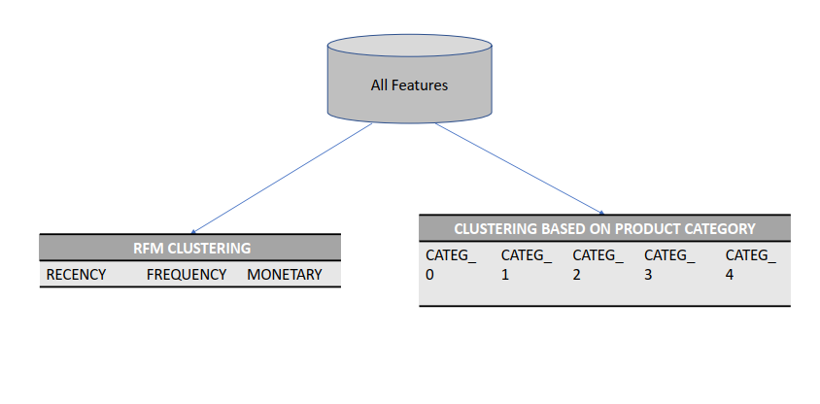
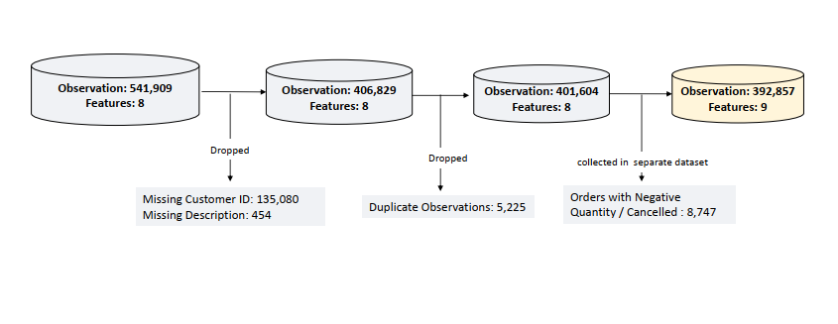
Database preprocessing

Slide 6
Project Objective
To be on par with the competition in market online (E-commerce Websites) and offline (Retail Shops) companies wants to understand their customers buying preferences, age, buying habits, buying frequencies etc. in order to:
Pinpoint their marketing and sales strategy.
Differentiate between their different target audience to promote their products.
Determine the customer loyalty to the company and take actions accordingly.
Here we are going to segregate into five groups Premium, Valuable, Good, Average and Bad using RFM model.
Next we will apply unsupervised machine learning technique called K-Means to group those customers into different groups based on RFM score calculator.

Slide 7
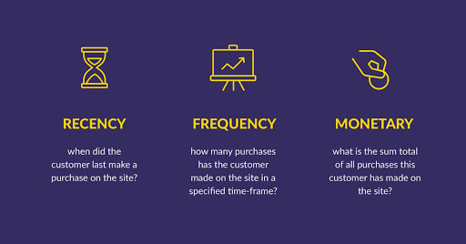
methodology
Calculate RFM Score
Here we will first utilize RFM modeling to calculate the RFM scores for each customers. RFM stands for Recency, Frequency and Monetary.
Recency : It means how recently a customer purchased an item or product. The more the recent purchase is the better the score would be.
Frequency: It means how recently a customer purchased an item or product. The more the recent purchase is the better the score would be.
Monetary: It means how recently a customer purchased an item or product. The more the recent purchase is the better the score would be.

Slide 8
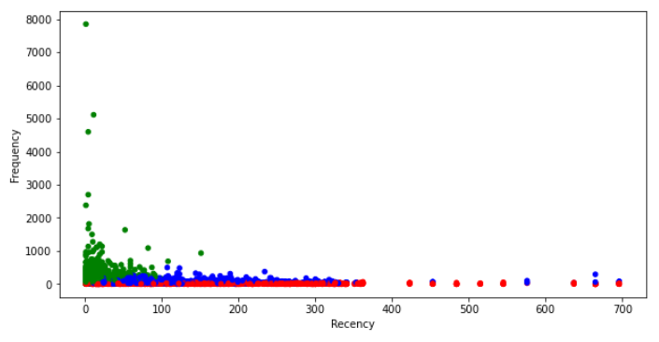
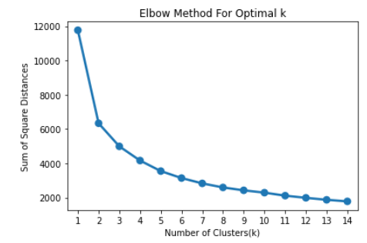
methodology
Create clusters using K-Means
Next we will apply unsupervised machine learning technique called K-Means to group those customers into different groups based on RFM score calculator.

Slide 9
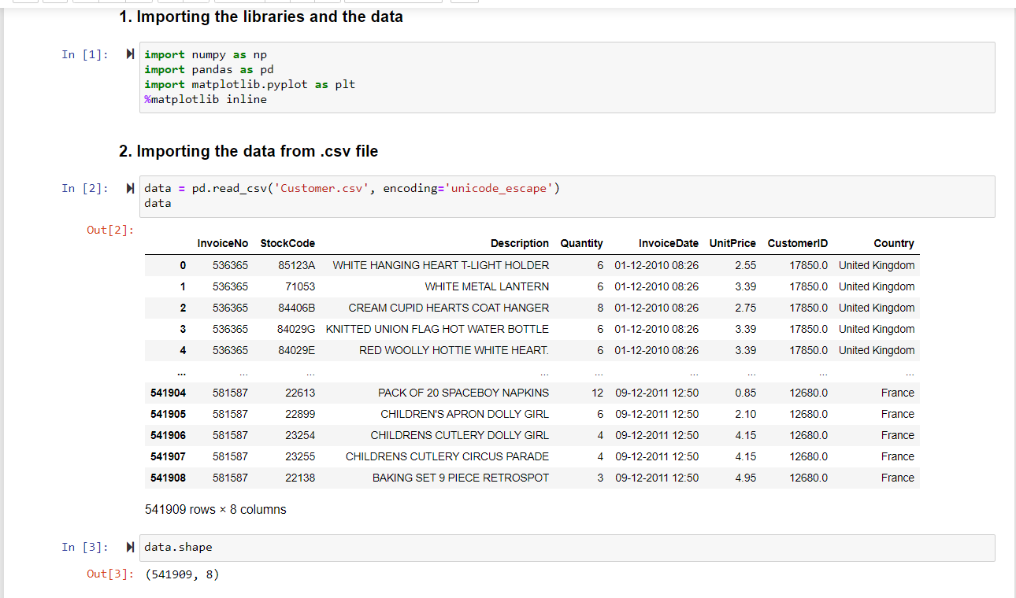
Implementation

Slide 10
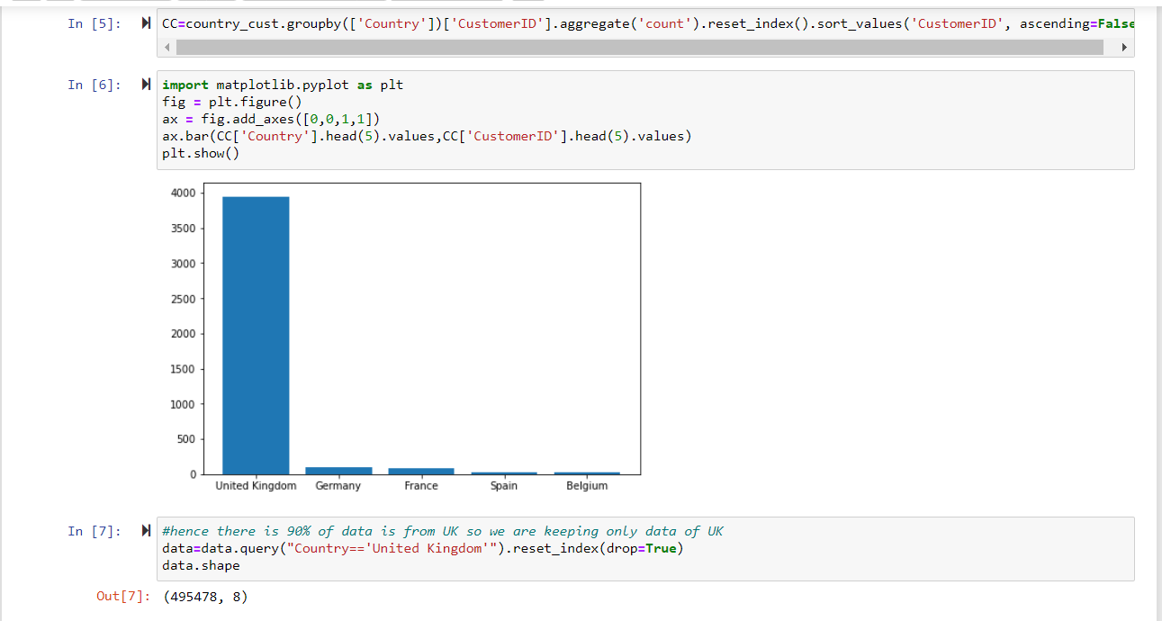

Slide 11
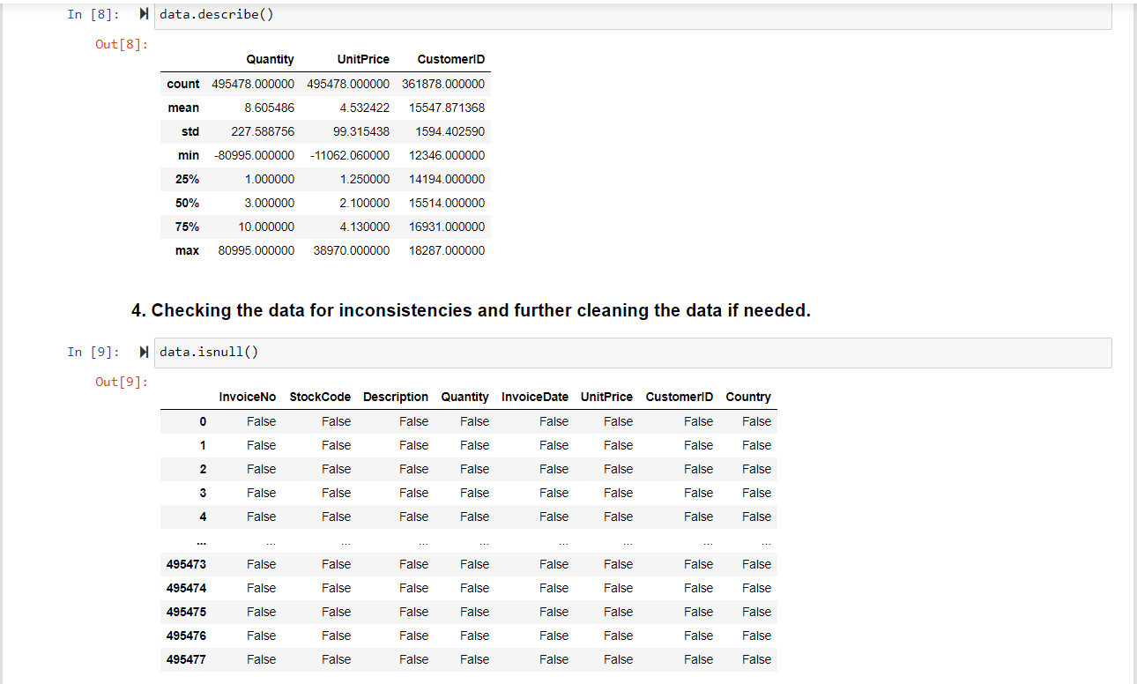

Slide 12
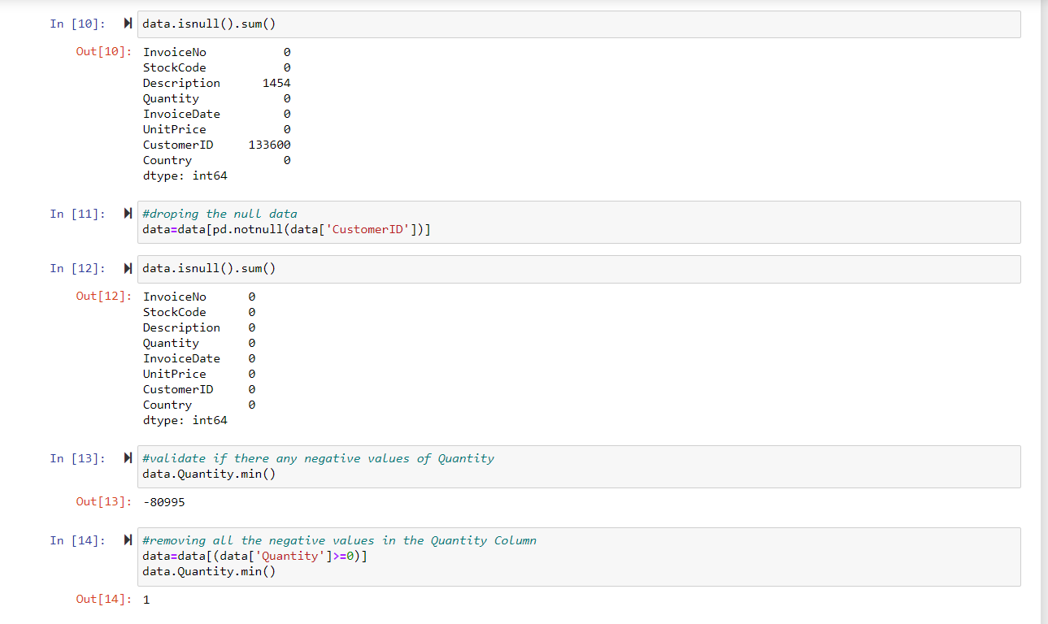

Slide 13
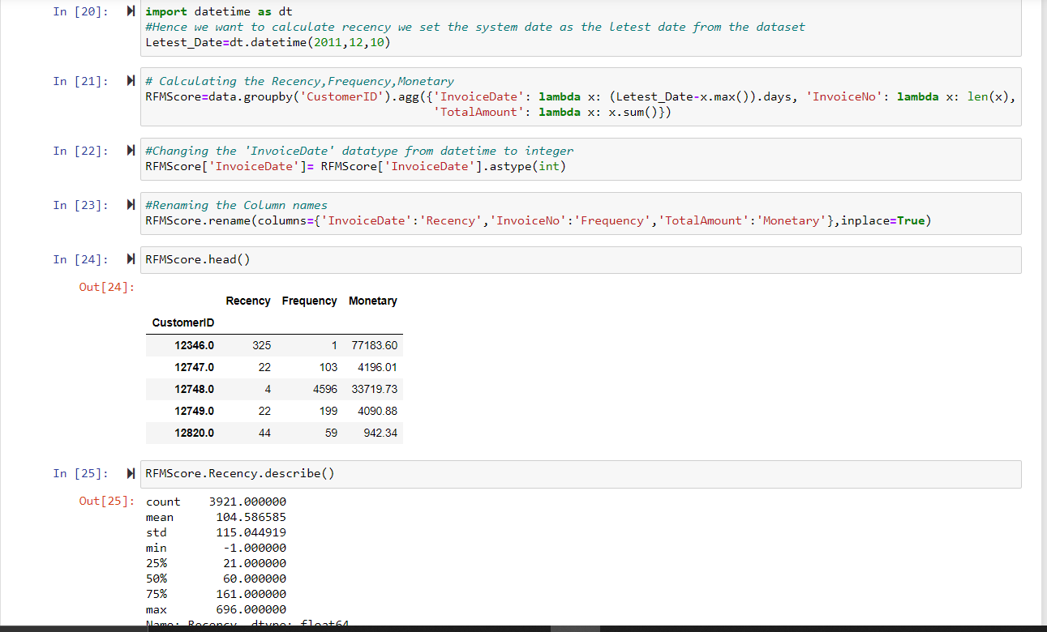

Slide 14
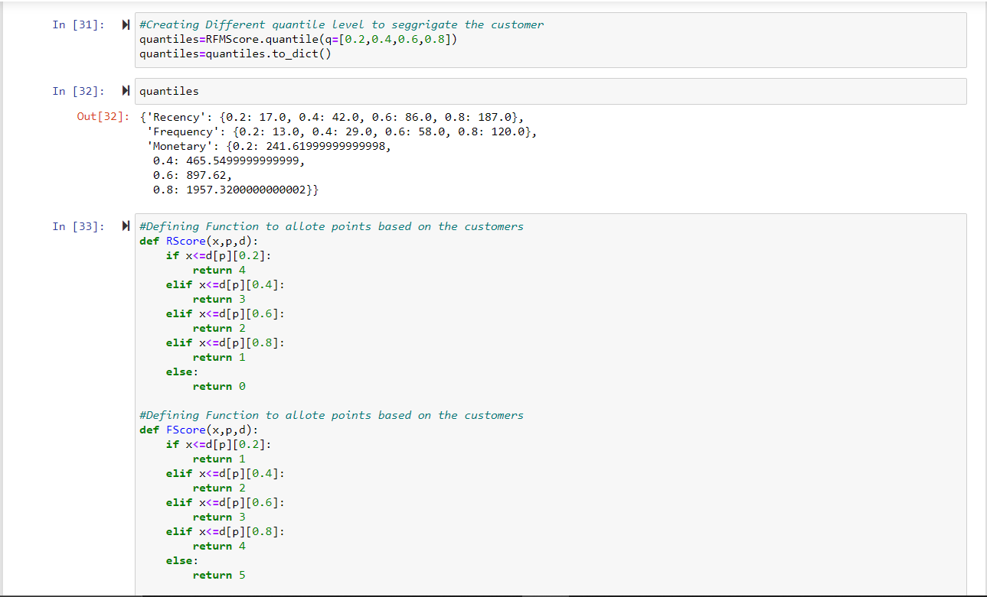

Slide 15
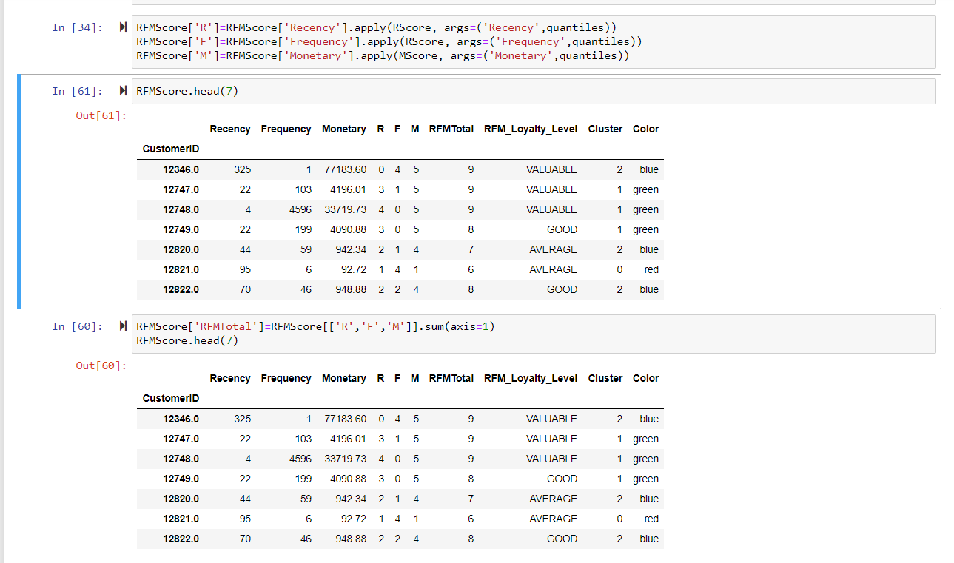

Slide 16
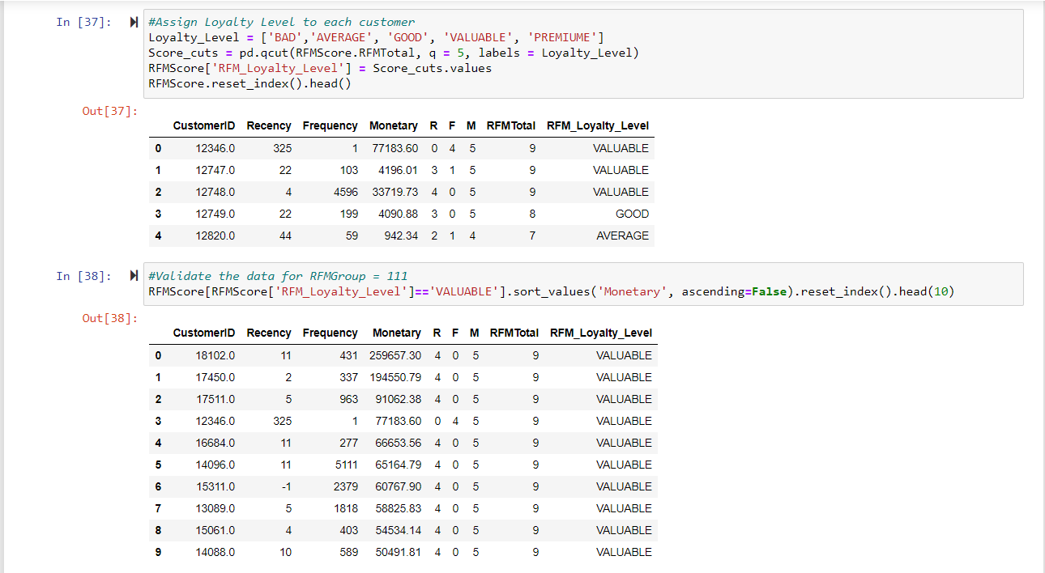

Slide 17
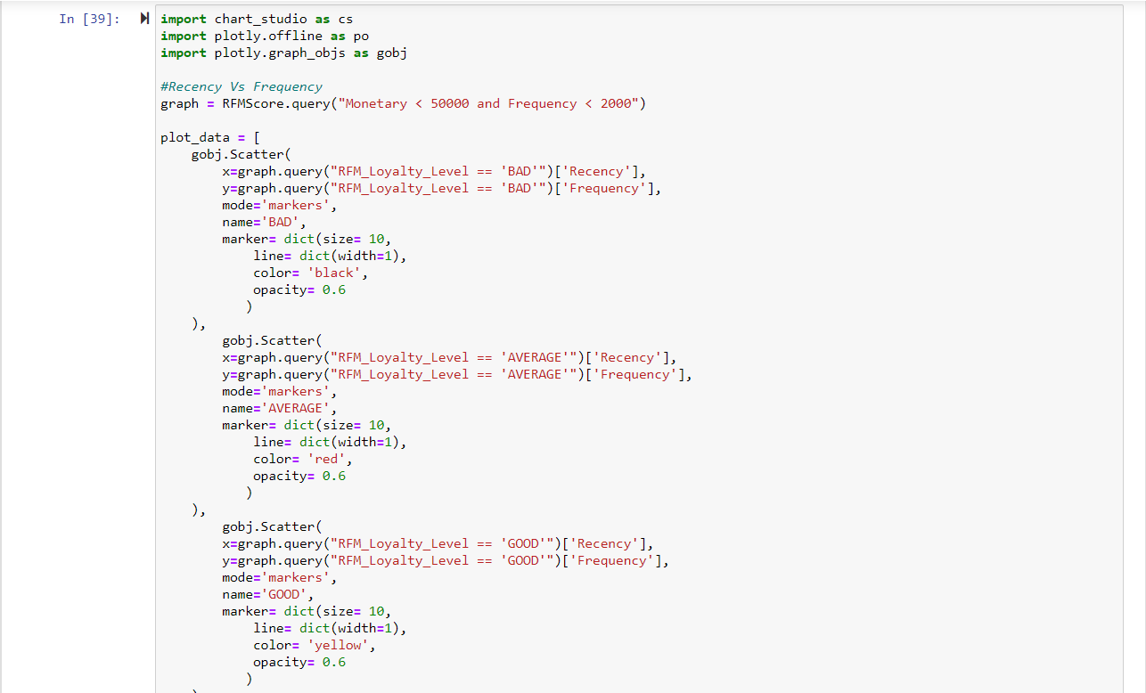

Slide 18
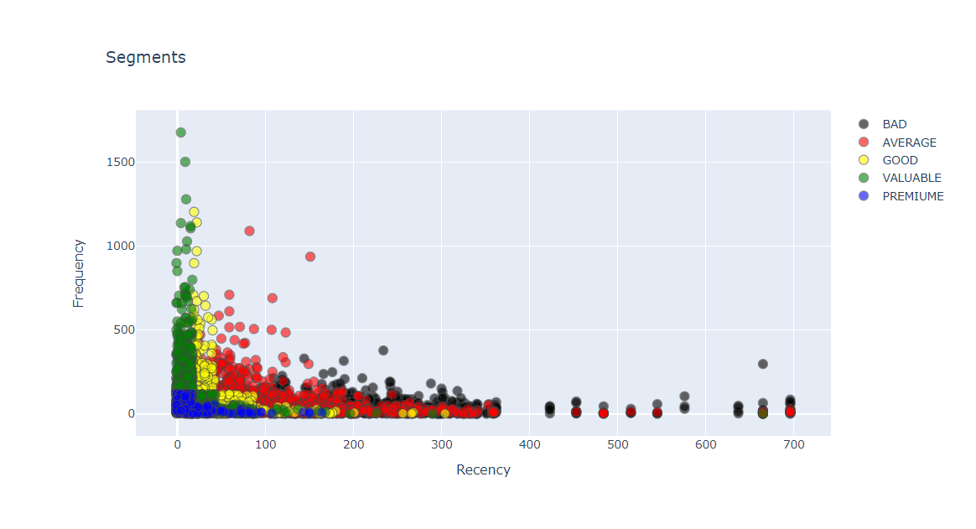
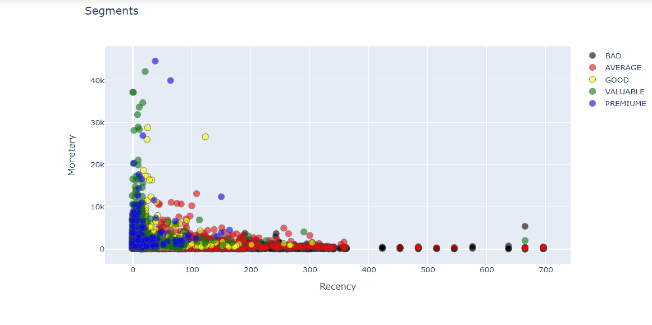
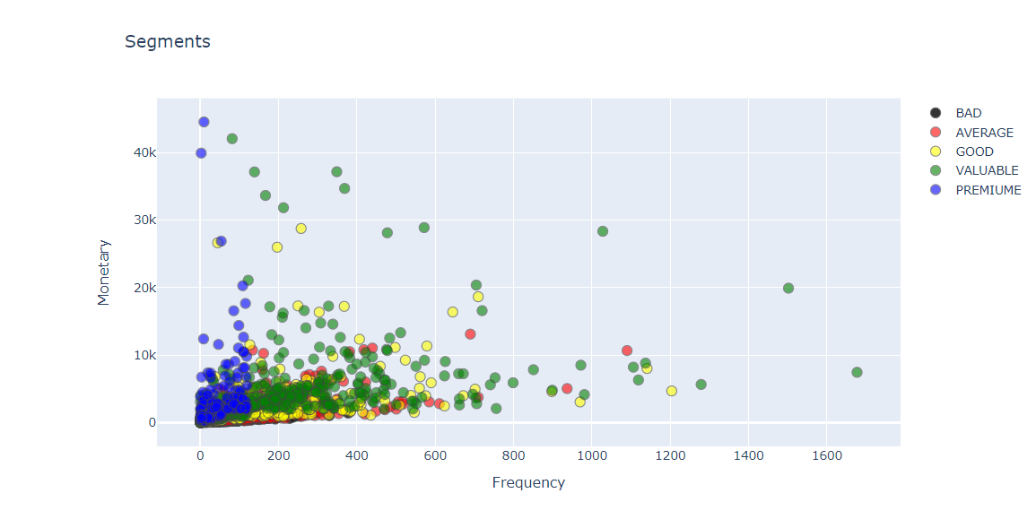

Slide 19
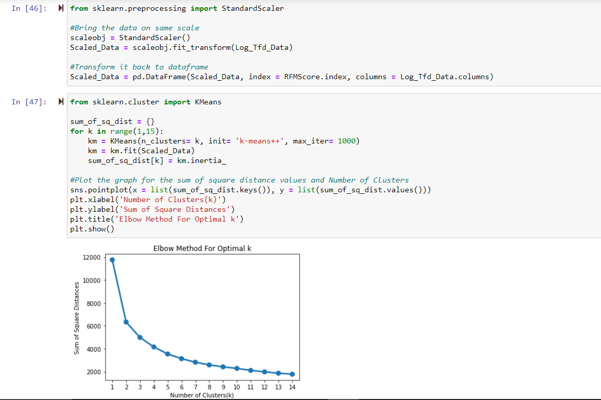

Slide 20
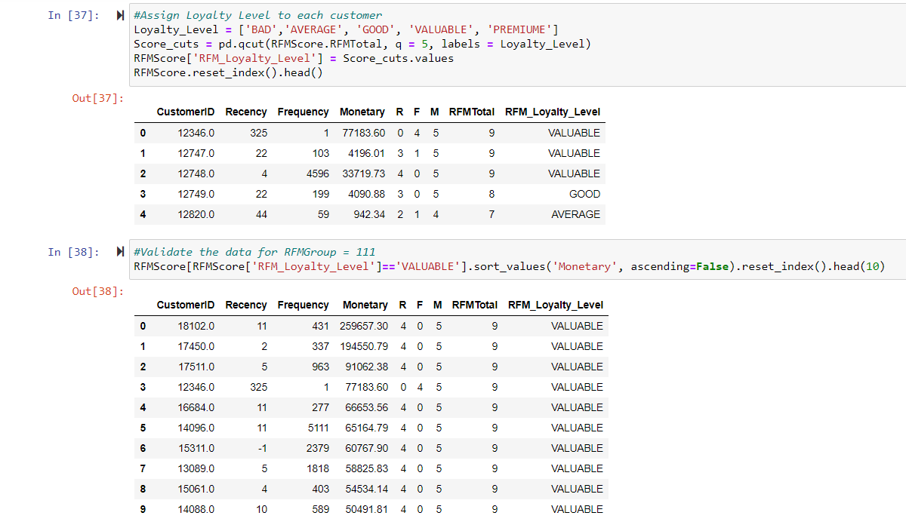

Slide 21
